Slide 1
Data Cleaning and EDA
LECTURE 6
Exploratory data analysis and its role in the data science lifecycle.
Sean Kang

Slide 2
Quick Recap Pandas and Jupyter Notebooks
Reviewing DataFrame concepts
Series: A named column of data with an index
Indexes: The mapping from keys to rows
DataFrame: collection of series with common index
Dataframe access methods
Filtering on predicts and slicing
df.loc: location by index
df.iloc: location by integer address
groupby & pivot aggregating data

Slide 3

You have collected or been given a box of data?
Box of Data
What do you do next?

Slide 4


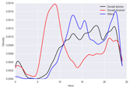
Question & Problem Formulation
?
Data Acquisition
Prediction and Inference
Exploratory Data Analysis

Slide 5

Question & Problem Formulation
?
Topics For This Lecture
Data Acquisition
Understanding the Data
Data Cleaning
Exploratory Data Analysis (EDA)
Basic data visualization
Common Data Anomalies
… and how to fix them
Prediction and Inference
Exploratory Data Analysis

Slide 6
Data Cleaning
Exploratory Data
Analysis
… the infinite loop of data science.

Slide 7
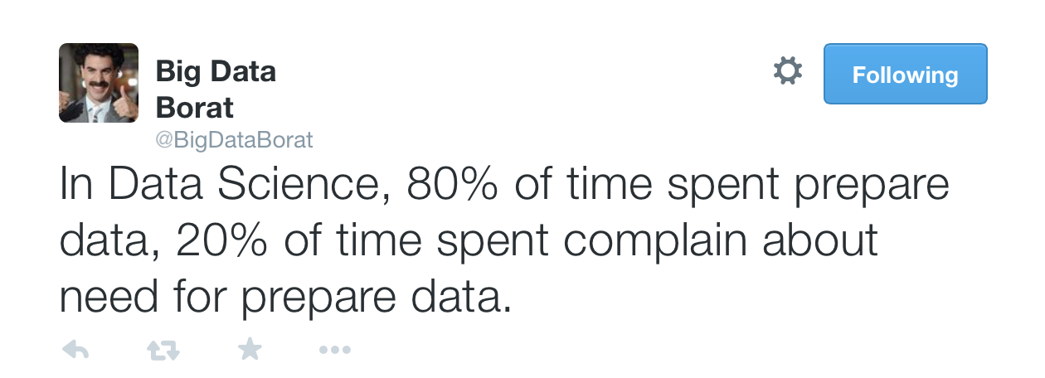
Data Cleaning
The process of transforming raw data to facilitate subsequent analysis
Data cleaning often addresses issues
structure / formatting
missing or corrupted values
unit conversion
encoding text as numbers
…
Sadly, data cleaning is a big part of data science… (Large part of the time is spent here)

Slide 8
(EDA)
Exploratory Data Analysis
“Getting to know the data”
The process of transforming, visualizing, and summarizing data to:
Build/confirm understanding of the data and its provenance
Identify and address potential issues in the data
Inform the subsequent analysis
Journaling the data changes, or the way the data has been reformatted is an important part of the data transformation.
discover potential hypothesis … (be careful)
EDA is an open-ended analysis
Be willing to find something surprising
Notes:
Provenance: is the data in its original form or has it changed? through what operations?
Inform the subsequent analysis: Document what you have done to inform others about types of transformations you did
-- Does Yahoo Finance data the original data? Or did Yahoo Finance harvest the data from the original source and reformat it for its purposes.

Slide 9

John Tukey
Princeton Mathematician & Statistician
Introduced
“Bit” : binary digit
Exploratory Data Analysis (book)
Early Data Scientist
Data Analysis & Statistics, Tukey 1965
Image from LIFE Magazine
Notes:
John Tukey, Princeton mathematician and statistician, inventor of the Fast Fourier Transform and father of Exploratory Data Analysis. Also coined the word “bit”.
Emphasis courtesy Jeff Heer, U. Washington

Slide 10
Data Types

Slide 11
Data
Note that categorical variables can have numeric levels and quantitative variables may be stored as strings.
Ratios and intervals have meaning.
Quantitative
Qualitative
Continuous
Discrete
Ordinal
Nominal
Could be measured to arbitrary precision.
Finite possible values
Categories w/ levels but no consistent meaning to difference
Categories w/ no
specific ordering.
Examples:
Price
Temperature
Examples:
Number of siblings
Yrs of education
Number of Lanes on Freeway
Examples:
Preferences
Level of education
Examples:
Political Affiliation (Demo, Republic, Ind, etc)
CallD number

Slide 12
What is the type of data?
 | Quantitative Continuous | Quantitative Discrete | Qualitative Ordinal | Qualitative Nominal
CO₂ level (PPM)
Number of siblings
GPA
Income bracket (low, med, high)
Race
Number of years of education
Yelp Rating

Slide 13
File Formats and Structure

Slide 14
What should we look for?

Slide 15
Key Data Properties to Consider in EDA
Structure -- the “shape” of a data file
Granularity -- how fine/coarse is each datum
Scope -- how (in)complete is the data
Temporality -- how is the data situated in time
Faithfulness -- how well does the data capture “reality”
Notes:
Granularity: If it is people data, does each row represent an individual? A group of individuals? Or a population?
If there is a timestamp, does that reflect when the data is collected? Does that reflect when the data is entered to the system?

Slide 16
Rectangular Data
Fields/Attributes/ Features/Columns
We prefer rectangular data for data analysis (why?)
Regular structures are easy manipulate and analyze
A big part of data cleaning is about transforming data to be more rectangular
Two kinds of rectangular data: Tables and Matrices
(what are the differences?)
Tables (a.k.a. data-frames in R/Python and relations in SQL)
Named columns with different types
Manipulated using data transformation languages (map, filter, group by, join, …)
Matrices
Numeric data of the same type
Manipulated using linear algebra
Will discuss this in the future for more in-depth data science, but in this lecture.
Records/Rows

Slide 17
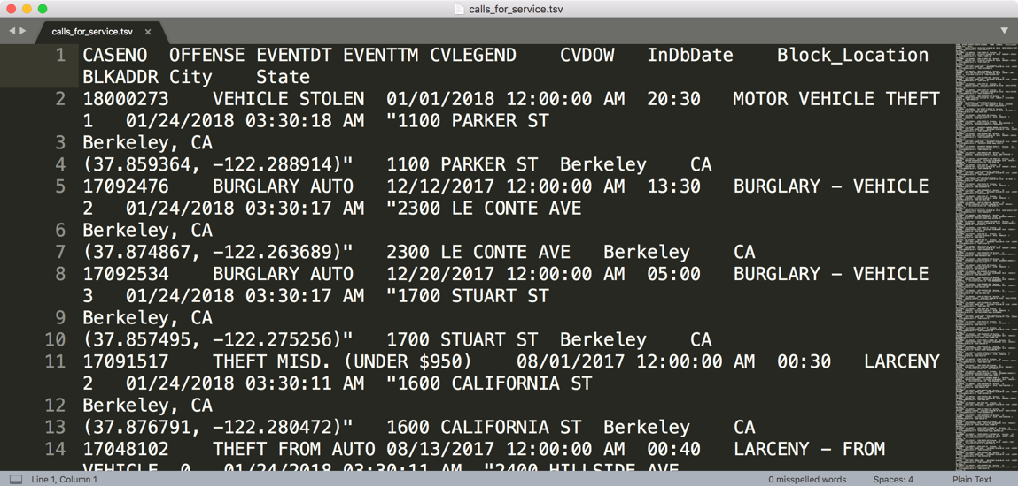
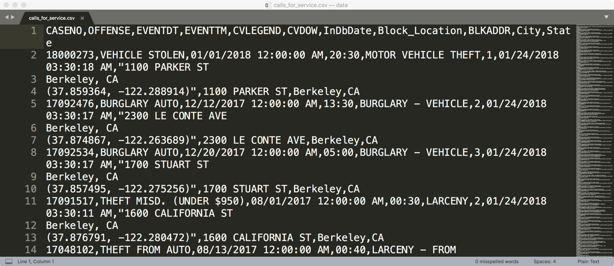
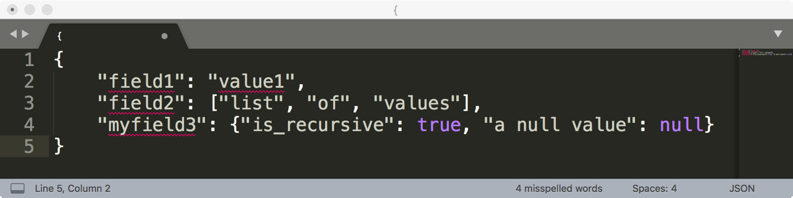
How are these data files formatted?
TSV
Tab separated values
Which is the best?
CSV
Comma separated values
JSON

Slide 18
Comma and Tab Separated Values Files
Tabular data where
Records are delimited by a newline: “\n”, “\r\n”
Fields are delimited by ‘,’ (comma) or ‘\t’ (tab)
Very Common!
Issues?
Commas, tabs in records
Quoting
…

Slide 19
JavaScript Object Notation (JSON)
Widely used file format for nested data
Very similar to python dictionaries
Strict formatting ”quoting” addresses some issues in CSV/TSV
Issues
Not rectangular
Each record can have different fields
Nesting means records can contain tables – complicated

Slide 20
Extensible Markup Language - XML (another kind of nested data)
<catalog>
<plant type='a'>
<common>Bloodroot</common>
<botanical>Sanguinaria canadensis</botanical>
<zone>4</zone>
<light>Mostly Shady</light>
<price>2.44</price>
<availability>03/15/2006</availability>
<description>
<color>white</color>
<petals>true</petals>
</description>
<indoor>true</indoor>
</plant>
…
</catalog>
Nested structure
Notes:
anything in brackets is markup; only 4 pieces of information

Slide 21
Log Data
Is this a csv file? tsv?
JSON/XML?
169.237.46.168 - - [26/Jan/2014:10:47:58 -0800] "GET /stat141/Winter04 HTTP/1.1" 301 328 "http://anson.ucdavis.edu/courses/" "Mozilla/4.0 (compatible; MSIE 6.0; Windows NT 5.0; .NET CLR 1.1.4322)”
169.237.6.168 - - [8/Jan/2014:10:47:58 -0800] "GET /stat141/Winter04/ HTTP/1.1" 200 2585 "http://anson.ucdavis.edu/courses/" "Mozilla/4.0 (compatible; MSIE 6.0; Windows NT 5.0; .NET CLR 1.1.4322)"

Slide 22
Keys and Joins

Slide 23
Structure: Keys
Primary Key
Purchases.csv
OrderNum | ProdID | Quantity
1 | 42 | 3
1 | 999 | 2
2 | 42 | 1
Often data will reference other pieces of data
Primary key: the column or set of columns in a table that determine the values of the remaining columns
Primary keys are unique
Examples: SSN, ProductIDs, …
Orders.csv
OrderNum | CustID | Date
1 | 171345 | 8/21/2017
2 | 281139 | 8/30/2017
Products.csv
ProdID | Cost
42 | 3.14
999 | 2.72
Primary Key
Customers.csv
CustID | Addr
171345 | Harmon..
281139 | Main ..

Slide 24
Structure: Keys
Primary Key
Purchases.csv
OrderNum | ProdID | Quantity
1 | 42 | 3
1 | 999 | 2
2 | 42 | 1
Often data will reference other pieces of data
Primary key: the column or set of columns in a table that determine the values of the remaining columns
Primary keys are unique
Examples: SSN, ProductIDs, …
Foreign keys: the column or sets of columns that reference primary keys in other tables.
You will need to join across tables
Foreign Key
Orders.csv
OrderNum | CustID | Date
1 | 171345 | 8/21/2017
2 | 281139 | 8/30/2017
Products.csv
ProdID | Cost
42 | 3.14
999 | 2.72
Primary Key
Customers.csv
CustID | Addr
171345 | Harmon..
281139 | Main ..

Slide 25
Questions to ask about Structure
Are the data in a standard format or encoding?
Tabular data: CSV, TSV, Excel, SQL
Nested data: JSON or XML
Are the data organized in “records”?
No: Can we define records by parsing the data?
Are the data nested? (records contained within records…)
Yes: Can we reasonably un-nest the data?
Does the data reference other data?
Yes: can we join/merge the data
What are the fields in each record?
How are they encoded? (e.g., strings, numbers, binary, dates …)
What is the type of the data?

Slide 26
Concepts and Terminology of Tables in Data Mining
There are two types of tables in Data Mining: Fact Table and Dimensional Table
Fact table: contains the main data.
Dimensional table: supports the fact table
Examples of Fact Table
Call Service Record
Medical Tests
Examples of Dimensional Table
Types of service calls
Referenced by Fact table by foreign keys

Slide 27
Summary

Slide 28
Summary: How do you do EDA/Data Cleaning?
Examine data and metadata:
What is the date, size, organization, and structure of the data?
Examine each field/attribute/dimension individually
Examine pairs of related dimensions
Stratifying earlier analysis: break down grades by major …
Along the way:
Visualize/summarize the data
Validate assumptions about data and collection process
Identify and address anomalies
Apply data transformations and corrections
Record everything you do! (why?)

